Slide 1
Mid-term Mobile app
Cim613
Cosmetic helping
Xing Liu

Slide 2
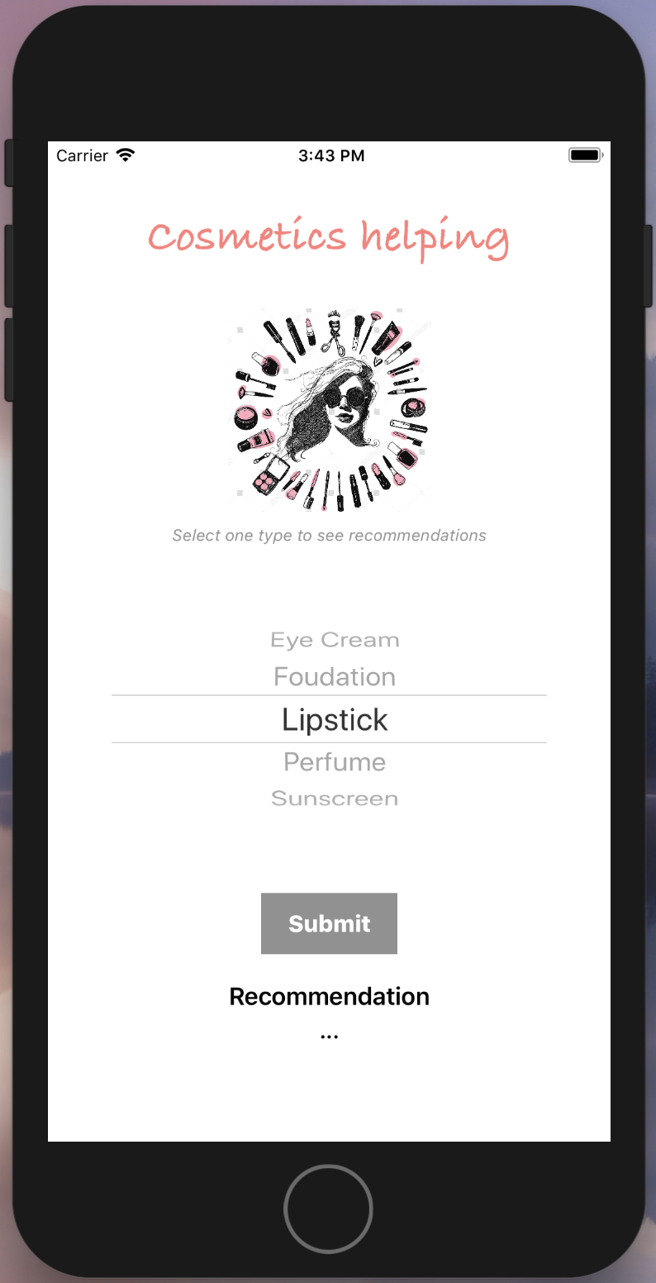
Introduction
cosmetic helping
Description
This app is to help people choose cosmetics.
Objective
Help people to choose a cosmetics based on the type(such as foundation, perfume, lipstick) they want to buy.

Slide 3
Introduction
Motivation
There are so many brands to choose from. Sometimes it is a little hard to select one cosmetics from numerous brands. This is always the case with me.
Target users
People who use cosmetics
People want to buy cosmetics for others

Slide 4
Description & logic path
Description
4 labels
1 image view
1 picker view
1 button
Label: name for this app
Image View: picture for the cosmetics
Label: instructions
Picker View: select types
Button: submit
Label: showing the result
Label: recommendation

Slide 5
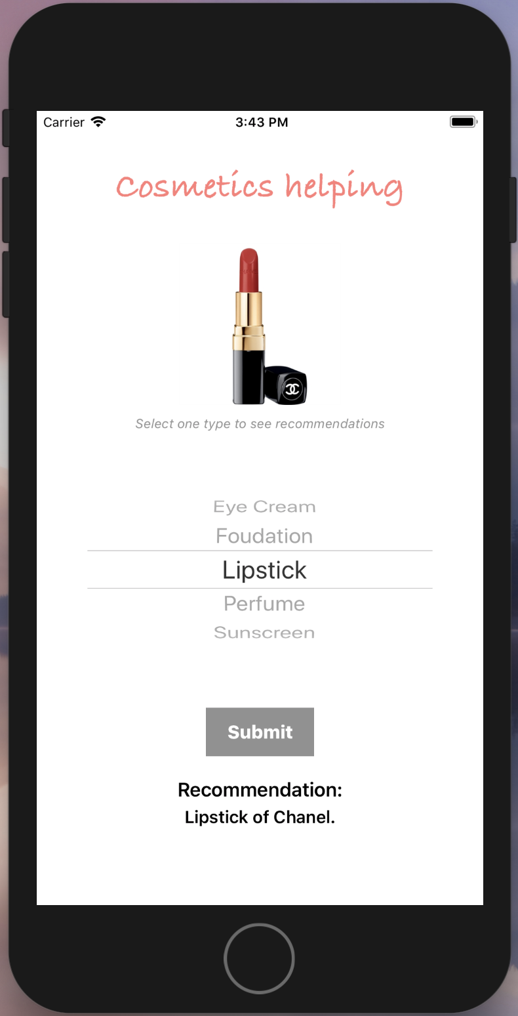
Description & logic path
Logic path
page1
page2
Step3: Show the image results here.
Step1:Slide the picker to select a type, for example: choose the lipstick.
Step2:Press the “Submit "button.
Step3: Show the text(randomly generated) results here.

Slide 6
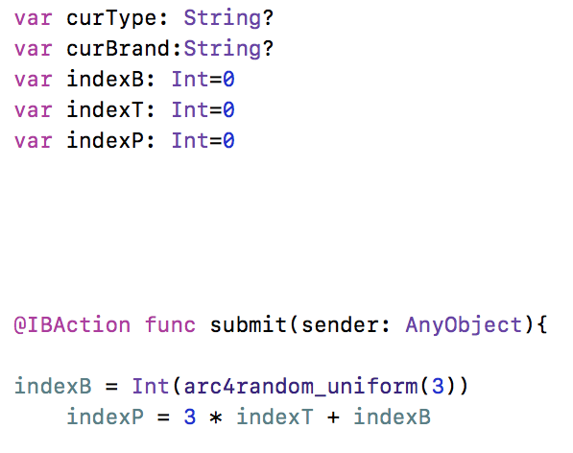
Implementation issues
#1
Issues
Randomize the brands.
solutions
Use a index number (var:indexB) to present the number of brand.
Use ” indexB = Int(arc4random_uniform(3))” to random brands

Slide 7
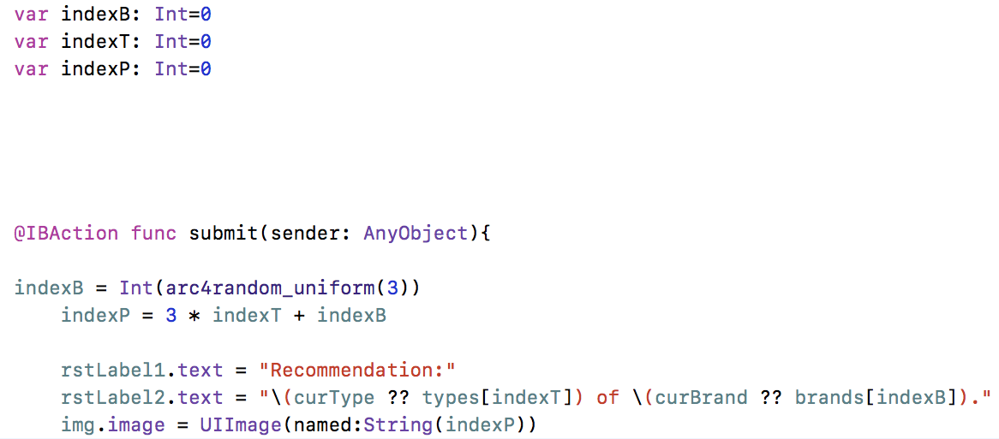
Implementation issues
#2
Issues
Associate pictures with corresponding cosmetics.
solutions
Use a index number (var:indexP) to present the name of the picture.
use two index numbers (var:indexT, var: indexB) to present the sequence for the two arrays (types and brands)
write an equation (indexP = 3 * indexT + indexB) for the calculation in order to connect the number of cosmetic with the corresponding picture.

Slide 8
Demonstration of the app
Watch the demo

Slide 9
Thank you!

